Slide 1
How is AI helpful in the medical field and specifically detecting early signs of cancer using AI?
Elisa Flores
CSIT 100
Professor Kaplun
24 November 2025

Slide 2
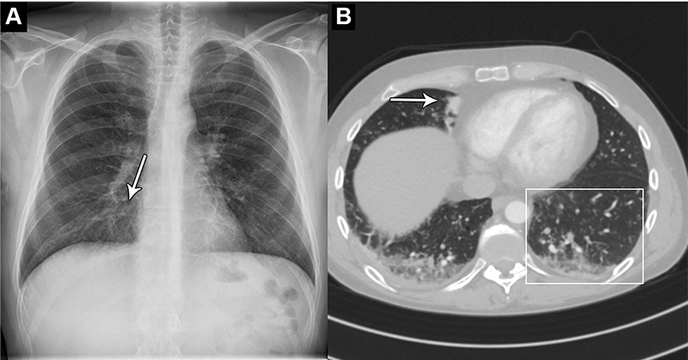
Introduction to AI in Healthcare
Company Name
Date
AI helps doctors process huge amounts of data that would be impossible to analyze manually. Machine learning allows computers to recognize patterns and make predictions without explicit instructions, supporting better clinical decisions.

Slide 3
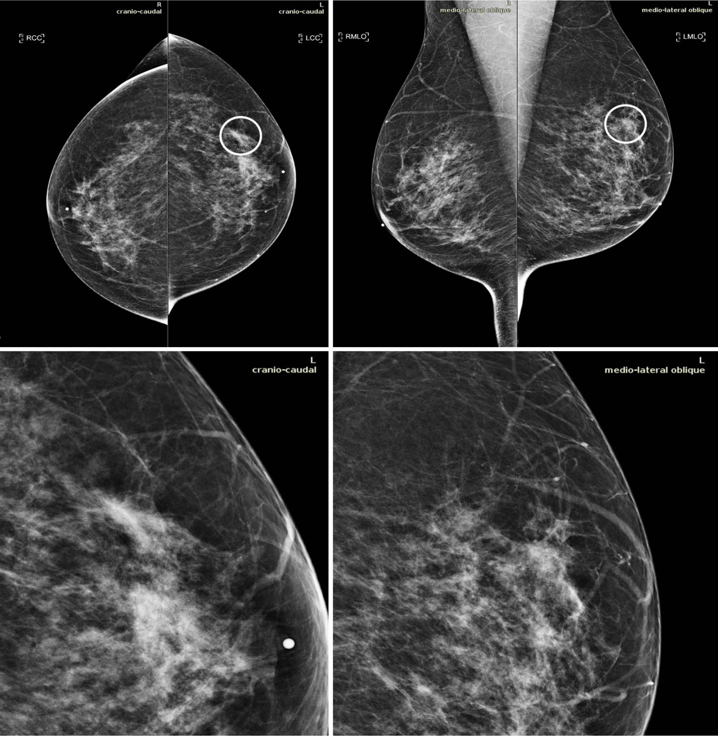
Company Name
Date
Why Early Cancer Detection Matters
Catching cancer early is critical. When detected early, treatments are less invasive, more effective, and survival rates improve. AI plays a key role in spotting subtle signs that humans may miss.

Slide 4
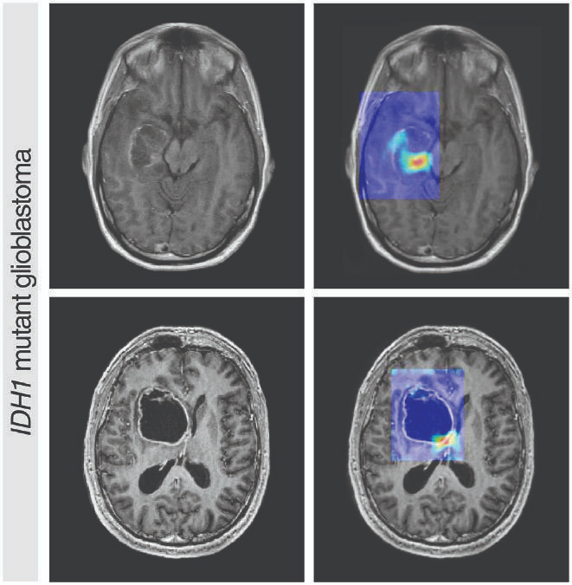
AI in Medical Imaging
Deep learning models, especially convolutional neural networks, can identify subtle changes in medical images that might be overlooked by radiologists, improving early cancer detection.

Slide 5
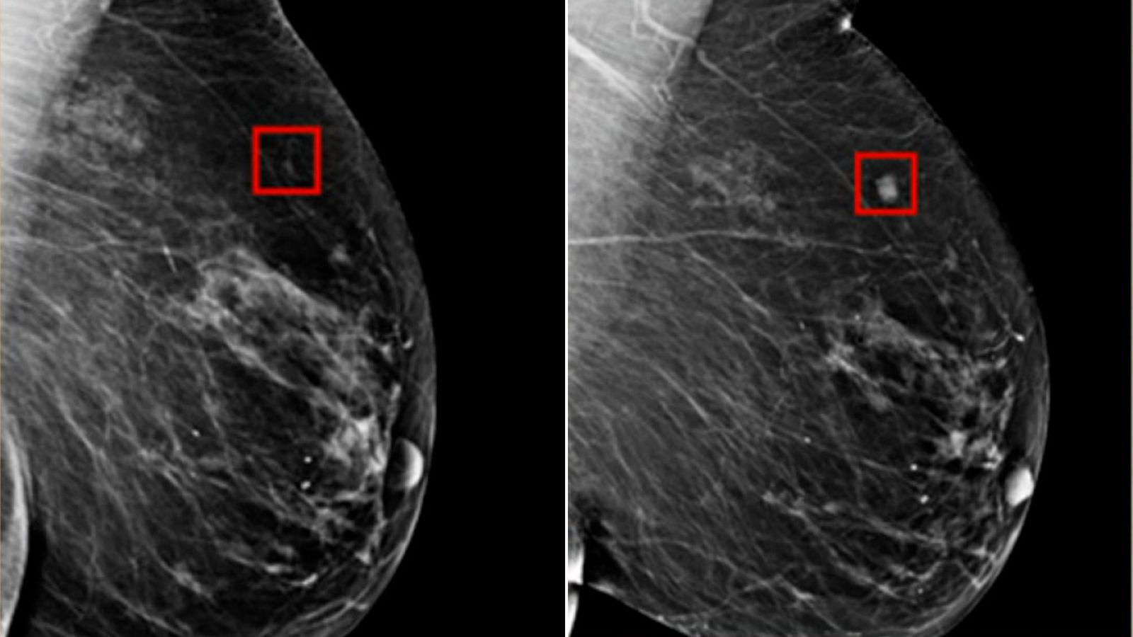
Real-World AI Applications – Google Health
Google Health’s AI models have shown they can spot tiny signs of breast cancer in mammograms. By highlighting these areas, doctors can examine them more closely, increasing early detection and accuracy.

Slide 6
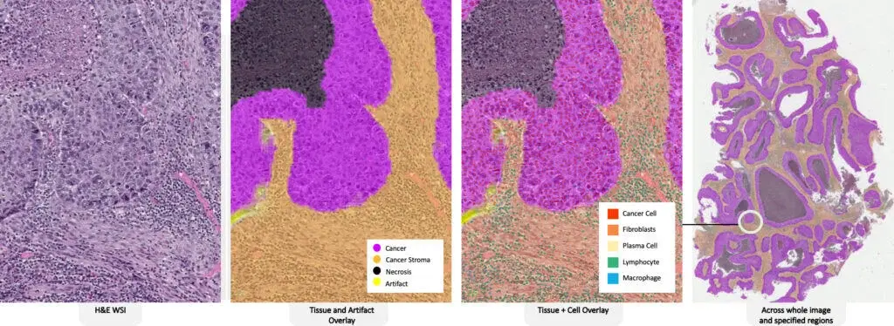
AI in Pathology – PathAI
Pathologists usually examine tissue slices under a microscope, which is time-consuming and prone to fatigue. PathAI’s system scans entire slides and helps pathologists identify problematic areas efficiently.

Slide 7
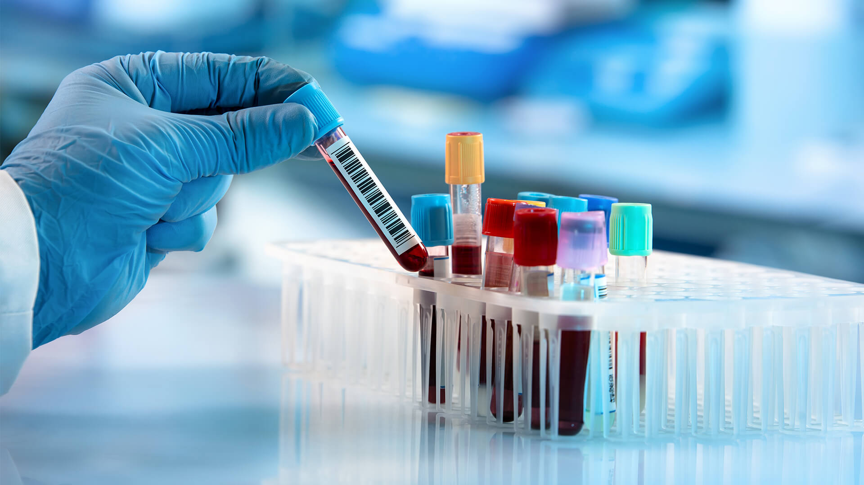
AI-Powered Blood Tests
Blood tests powered by AI can detect cancer before symptoms appear. This is a huge leap for early detection and could change screening practices worldwide.

Slide 8
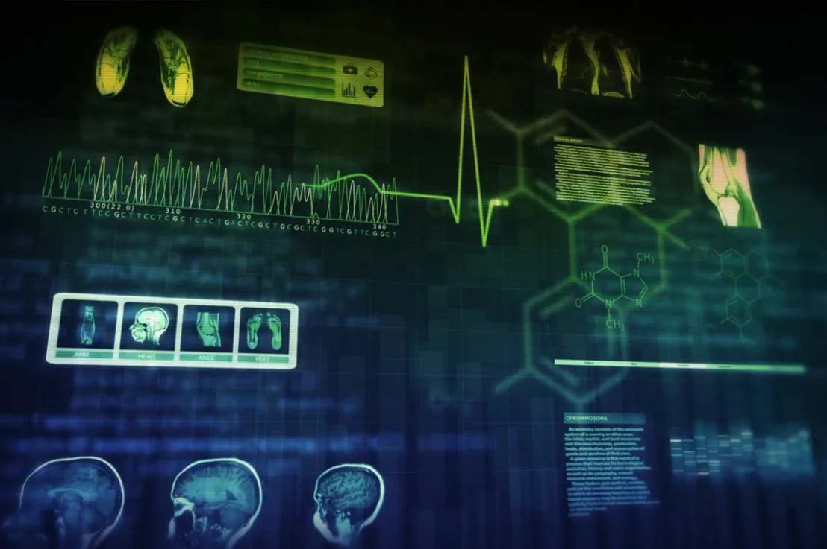
Other AI Tools – IBM Watson for Oncology
IBM Watson for Oncology helps doctors by analyzing large volumes of research and patient data to suggest tailored treatment options. AI is meant to assist medical professionals, not replace them.

Slide 9
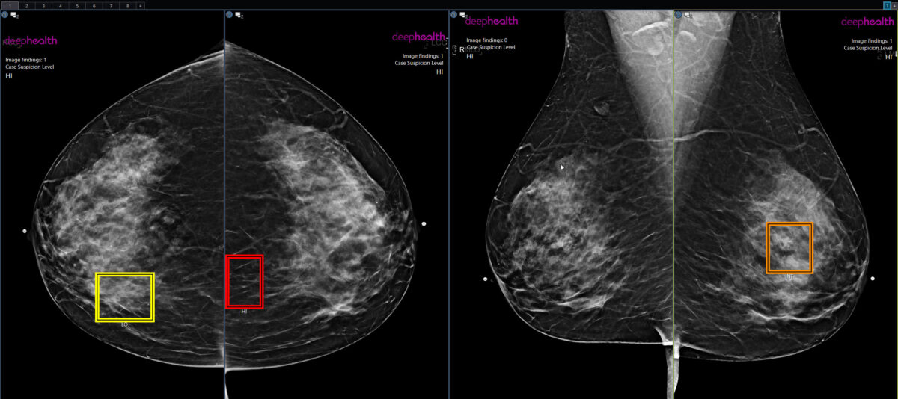
Benefits of AI in Cancer Detection
AI not only helps catch cancer early but also improves efficiency, reduces human error, and supports rural hospitals that may lack specialists, ultimately reducing healthcare costs.

Slide 10
Challenges of AI in Healthcare
Despite its benefits, AI has limitations. It may be biased if trained on non-diverse data, some models are not explainable, and privacy is a major concern. Legal and ethical issues must also be considered.

Slide 11
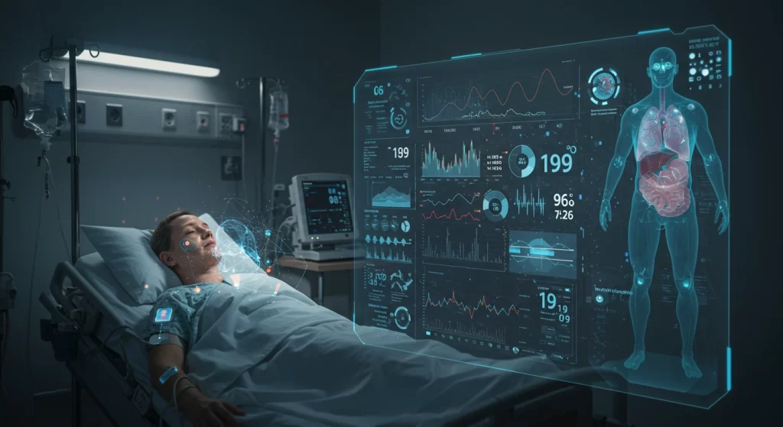
The Future of AI in Oncology
The future of AI in oncology is exciting. AI could monitor patients in real time, combine multiple data sources for risk assessment, and improve treatments through robotics and telemedicine, making healthcare more proactive and precise.

Slide 12
Conclusion
AI is transforming healthcare and early cancer detection.
Identifies subtle patterns in images, tissues, and blood.
Supports doctors, improves outcomes, reduces costs, and expands access.
Challenges that remain: bias, privacy, and regulation.

Slide 13
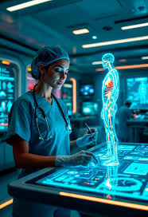
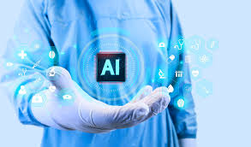
Thank you!

